Slide 1


STATE BAR OF MICHIGAN GOVERNMENT LAW SECTION & MICHIGAN ASSOCIATION OF MUNICIPAL ATTORNEYS SUMMER CONFERENCE
PROTEC Presentation On:
Law Affecting ROW and Public Spaces at The Intersection of Local ROW and “Utilities”
Michael J. Watza
Bloom Sluggett PC https://bloomsluggett.com/
General Counsel to PROTEC https://www.protec-mi.org/
Counsel to Merit Network https://www.merit.edu/
Detroit Office
400 Renaissance Center
Ste. 2600
Detroit, MI 48243
O: 313.309.7288
C: 248.921.3888
F: 616.965.9350 mike@bloomsluggett.com

Slide 2
Quick Refences
Michigan 1963 Constitution Art 7 sec 29
https://www.legislature.mi.gov/Laws/MCL?objectName=MCL-ARTICLE-VII-29
Metro Act
https://www.legislature.mi.gov/Laws/MCL?objectName=mcl-Act-48-of-2002
Telecommunication Services Offered by Public Entity 2005 PA 235; MCL 484.2252
https://www.legislature.mi.gov/Laws/MCL?objectName=mcl-484-2252
“Small Cell Act”
https://www.legislature.mi.gov/Laws/MCL?objectName=mcl-Act-365-of-2018
Uniform Video Services Local Franchise Act
https://www.legislature.mi.gov/Laws/MCL?objectName=mcl-act-480-of-2006
-------NEXT TIME ? ------
Cell Tower Act MCL 125.3514 (See also Federal Telecommunications Act Sec 6409)
https://www.legislature.mi.gov/Laws/MCL?objectName=MCL-125-3514
See Separate Handout Summaries of Several Acts
The Summaries of these Acts and references to others in this presentation, both State and Federal, are not legal advice. In the event of an issue arising implicating the issues discussed, seek advice from qualified municipal telecommunications counsel ☺

Slide 3
1963 Michigan Constitution Art 7 Sec 29 https://www.legislature.mi.gov/Laws/MCL?objectName=MCL-ARTICLE-VII-29
§ 29 Highways, streets, alleys, public places; control, use by public utilities.
No person, partnership, association or corporation, public or private, operating a public utility shall have the right to the use of the highways, streets, alleys or other public places of any county, township, city or village for wires, poles, pipes, tracks, conduits or other utility facilities, without the consent of the duly constituted authority of the county, township, city or village; or to transact local business therein without first obtaining a franchise from the township, city or village. Except as otherwise provided in this constitution the right of all counties, townships, cities and villages to the reasonable control of their highways, streets, alleys and public places is hereby reserved to such local units of government.

Slide 4
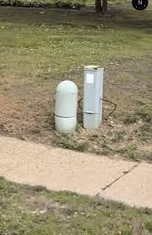
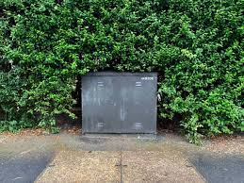
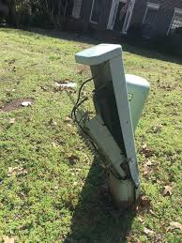
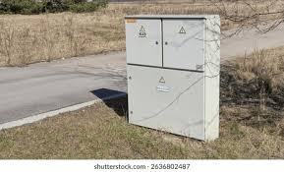
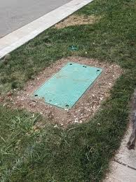
TELECOM JUNCTION BOXES
Sec 2j “lines” not “boxes” - What to do?

Slide 5
METRO ACT https://www.legislature.mi.gov/Laws/MCL?objectName=mcl-Act-48-of-2002
§ 1: Purpose: to encourage expansion of telecommunication services while allowing some control of public rights-of-way (ROWs) by municipalities.
§ 2: Definitions. The Act only applies to counties with a population of 10,000 or more. § 2(f). Lines Only. Equipment shelters and houses are excluded from “telecommunication facilities or facilities.” § 2(j).
§ 4: Municipality cannot enact or enforce an ordinance or assess fees for access to or use of public ROWs contrary to the Act or in addition to those in the Act. A METRO Act permit does not include use of Muni conduit or utility poles. § 4(3).
§ 8: Provider fee is generally $0.05 per linear foot of public ROW. Cable providers generally exempt. § 8(4), (11).
§ 10–12: The Fees collected are distributed annually based on Act 51 Highway Distribution formulas.
§ 14: Authority for Municipal Broadband for Residents: Municipality may provide telecommunication or cable modem services, if: (1) It does not discriminate against other providers of the same service and (2) It does not give itself preferential treatment in public ROW access, pole attachments, or rates for pole attachments. Exemptions: (1) Municipal systems used only by a municipality and (2) Grandfathered systems established before December 31, 2001. Municipal systems must also meet the requirements of MCL 484.2252.
§ 15: Shot Clock: Municipality has 45 days from the date an application is filed to approve or deny access to a public ROW. Bonds may be a condition of the permit.

Slide 6
Telecommunication Services by Public Entity 2005 PA 235; MCL 484.2252 https://www.legislature.mi.gov/Laws/MCL?objectName=mcl-484-2252
§ 1: Public Entity may provide Telecommunications Services within its boundaries but must comply with Metro Act 2002 PA 48, MCL 484.3114, and:
  Issue an RFP
  Receive less than 3 “qualified” bids
  Wait at least 60 days from the date the RFP was issued
  Comply with RFP terms in providing the services
§§ 2–3: Public Entity can provide beyond its borders if the other affected public entities comply with this Act.
§ 4: No independent Boards
§ 5. This Act does not apply to:
Public safety systems
System used by public entities only
Grandfathered Systems effective by November 1, 2005
System currently operating in another public entity
Services offered by a public entity to the public within a facility owned and operated by the public entity
Systems or services to advance public health, safety, and e-government services
§ 6: Municipal Electric is exempt if energy service related
§ 7: “Public entity” = County, City, Village, Township, or a related agency

Slide 7
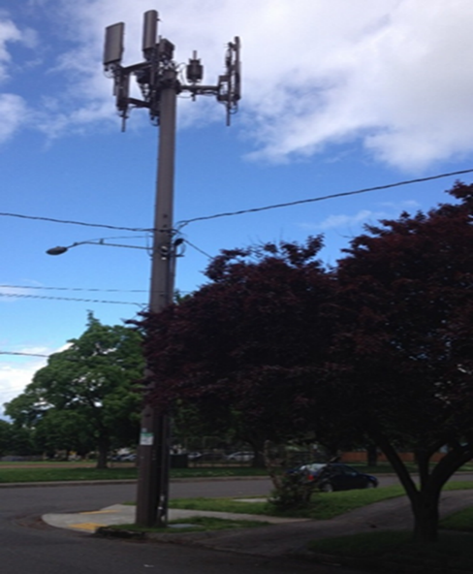
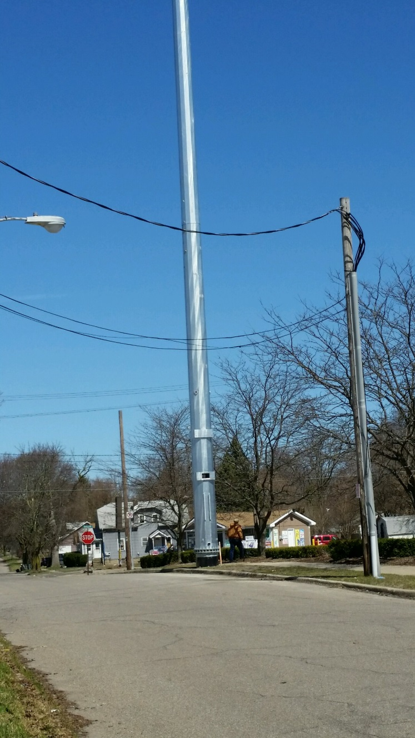
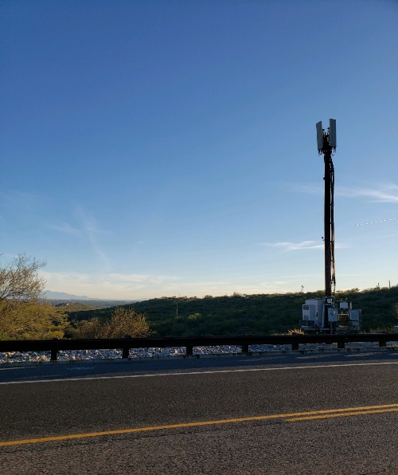
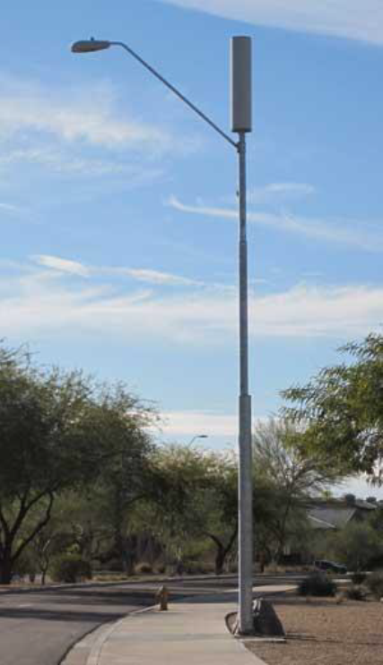
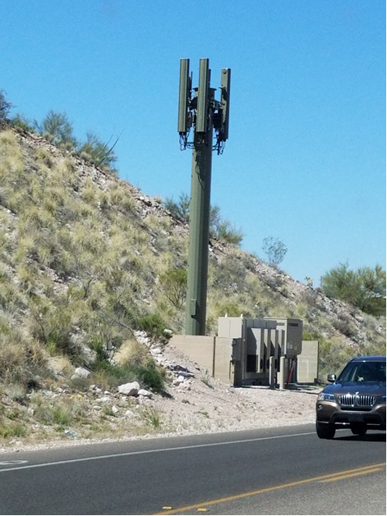
“Small" Isn’t So Small Is It?

Slide 8
SMALL CELL ACT https://www.legislature.mi.gov/Laws/MCL?objectName=mcl-Act-365-of-2018
§ 1: Purpose: to encourage expansion of wireless networks and access to wireless services while still allowing some control and management of public rights-of-way (ROWs) by municipalities
§ 3–9: Definitions. Micro wireless facility: no larger than 24"×15"×12"; exterior antenna no longer than 11". § 7(c). Small cell wireless facility: no larger than 6 ft; wireless equipment limited to 25 ft³ §7(j).
§ 13: No exclusive arrangement for use of public ROW. § 13(2). Annual collocation fee cap: $20 for poles erected before the Act’s effective date; $125 for poles erected on or after; 10% increase every 5 years. § 13(3). Facilities that meet height requirements of § 13(5) are not subject to zoning review or approval.
§§ 13-19 Fees & Timelines. See Summary Handout.
§ 33: Municipality may adopt bonding requirements up to $1,000 per facility if certain conditions are met.

Slide 9
Uniform Video Services Local Franchise Act 2006 PA 480; MCL 484.3301 et seq https://www.legislature.mi.gov/Laws/MCL?objectName=mcl-act-480-of-2006
§ 1: Definitions. § 1(2)(a)-(r). “Video service” means video programming, cable services, IPTV, or OVS provided through facilities located at least in part in the public rights-of-way without regard to delivery technology, including internet protocol technology . . . .” § 1(2)(p).
§ 2: 10 Year franchise required. Form set by State. Issued by Municipality. See Detroit v Comcast, 879 F Supp 2d 680 (ED Mich, 2012).
§ 3: Application: 15 business days to notify applicant if incomplete. 30 days to approve a complete application. Franchise transferable, modified or terminated with notice to franchisor. No in-kind demands permitted.
§ 4. Public Access, Education and Government (PEG) Channels: Maintain same number and quality of channels.
§ 5. Franchise Renewal: At discretion of Provider. See Dearborn v Comcast.
§ 6. Franchise Fee: Up to 5% of Gross Revenue derived from all sales within a franchisor’s boundaries. § 6(1)-(7). PEG Fees: Up to 2% of Gross Revenue. § 6(8)-(10). See FCC § 621 Orders.
§ 7: Audits: Franchisor may request a 24 month look back audit. 3-year Statute of Limitation. § 7(3)-(4). Fees may be itemized on subscriber bills. Not a “Pass thru”.
§ 8: Free Access to ROW and public places and buildings. (Due to Franchise)
§ 9: Anti-Redline Provision: Of limited value. See Federal Cable Act Requirements.
§ 10: Customer Service Rules for Providers and Dispute Resolution: Failure to resolve disputes prior to MPSC Final Ruling shall result in loser paying opposition’s actual costs.
§ 11: Trade Secrets including Areas of Coverage are FOIA exempt.
§ 12: MPSC to issues Annual Report on state of competition.
§ 13: Voluntary Franchise: Different Terms Permitted. All Providers to be provided same terms.

Slide 10
RR’s vs Telecoms
(Anybody Want to Buy a Ticket to That Scrap?)
January 24, 2025 165658 NORFOLK SOUTHERN RAILWAY COMPANY, Plaintiff-Appellant, v SC: 165658 COA: 359420 Ingham CC: 21-000332-CB METRO FIBERNET, LLC, Defendant-Appellee.
https://www.courts.michigan.gov/49d949/siteassets/case-documents/uploads/sct/public/orders/165658_122_01.pdf
The majority opinion, supported by Chief Justice Clement, held that Metronet was authorized to install underground cables under the railroad tracks as long as it obtained the necessary permits from the municipality, in accordance with Michigan Compiled Laws (MCL) 247.183(1) https://www.legislature.mi.gov/Laws/MCL?objectName=MCL-247-183 and MCL 484.3105. https://www.legislature.mi.gov/Laws/MCL?objectName=mcl-484-3105
Mich Locals and smaller telecoms? Going with the S Ct.
Larger Telecoms? Going with RR National Policies

Slide 11
To Do Next Time??
Michigan Zoning Enabling Act Re Cell Tower
Act 110 of 2006
  Versus Cell Towers on Municipal Property
  Federal Law Sec 6409 Etal
  Cells on Buildings – FCC OTARD Rules
Electric franchises
  Village of Lanse opinion
What Else?

Slide 12



Michael J. Watza Biography
Martindale Hubbell AV Rating
Super Lawyer Designation
Detroit Business Top Lawyer
Mr. Watza's practice provides litigated, legislative and regulatory solutions on behalf of municipal, and nonprofit sector clients concerning legislation, Complex Litigation, Governance Issues, Telecommunications including Cable and Cell Towers, Energy, Gaming and Insurance.
Michael has managed multiple legislative initiatives, represented clients in State and Federal trial and appellate courts as well as attended to regulatory matters before State agencies and the Federal Communications Commission and Department of Transportation (PHSMA).
Michael has represented clients in the halls of the Michigan Legislature and Congress through negotiation, drafting and testimony regarding legislation on various issues including energy, transmission line siting, telecommunications (cable and cell towers), pipeline regulation, the formation of inter-governmental authorities and tort reform.
Michael also serves as General Counsel to PROTEC - a consortium of over 100 communities, General counsel to Merit Network, a University affiliated nonprofit, Chair of the Novi EDC, Chair of Attorney Grievance Commission Grievance Panel #9, Past Chair of the Administrative and Regulatory Law Section of the State Bar and the Government Law Section of the State Bar, Chair of the International Municipal Lawyers Telecommunications Committee and past board member of the Michigan Gaming Control Board and Covenant House Central School Board in Detroit.
Michael has served as an adjunct faculty member at Michigan State University College of Law having taught Communications Law and Policy and Ethics and the Practice of Law and the faculty of the Michigan State University Institute for Public Utilities.
In 2008, Michael successfully led a coalition of Michigan Cities to Federal Court and Congress to oppose Comcast’s effort to move PEG channels to the 900 channel range resulting in, among other things, an apology by Comcast to Congress.
Michael provided the legal components to the development of the 1st new Municipal Broadband projects in Sebewaing, Marshall and several other communities across Michigan, as well as leading the defense of Rights of Way and Public Spaces across all industries that seek access.
    Michael J. Watza
    Bloom Sluggett PC
    400 RenCen
    Ste 2600
    Detroit, MI 48243
    mike@bloomsluggett.com
    248.921.3888

